Slide 1
A Novel Method For Fast Model Checking Project Report

Slide 2
The State Explosion Problem
The size of the state space is exponential in the number of model entities
For a Boolean model with N entities the size of the state space is 2^{N}
In an asynchronous (concurrent) model, a state may lead to several different states
One of the tricks used in model checking is to create a polynomial-size representation of the state space

Slide 3
State Space Representation
In a smaller state space representation checking whether a state is reachable becomes hard
This talk will be about Petri net models, and a technique for state space representation called Unfolding

Slide 4
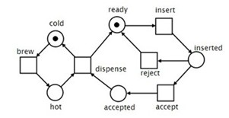
Petri Net Components
A transition (rectangle) consumes tokens (black dots) from input places (circles with outgoing edges) and produce tokens into output places (circles with incoming edges)

Slide 5
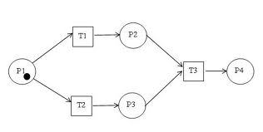
Petri Nets And Concurrency
Transitions can fire concurrently:
T3 cannot fire

Slide 6
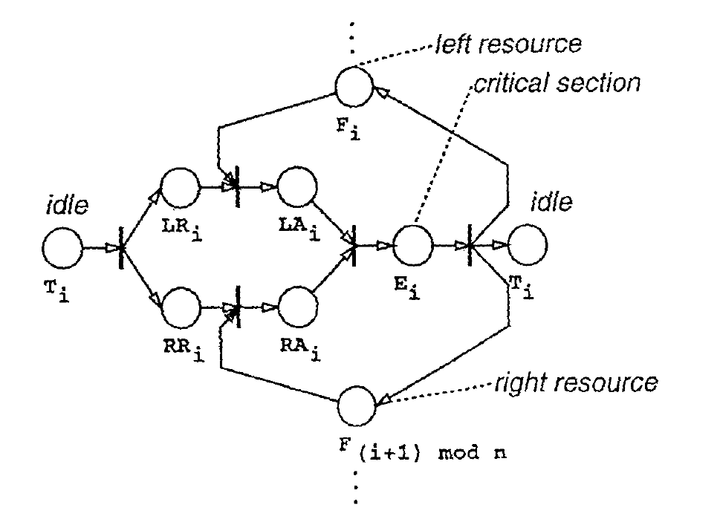
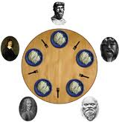
The Dining Philosophers Problem
thinking
eating
fork

Slide 7
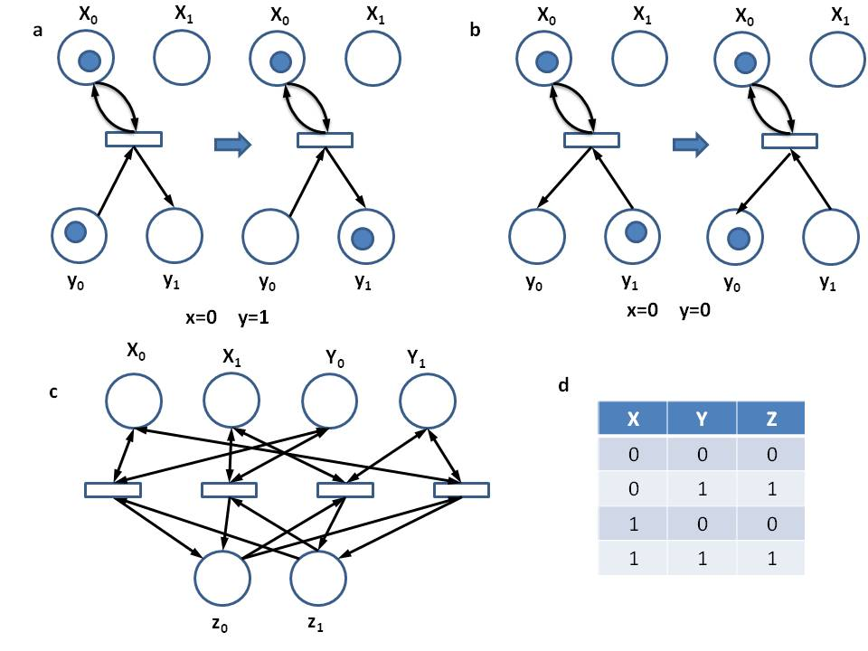
Truth Table Encoding

Slide 8
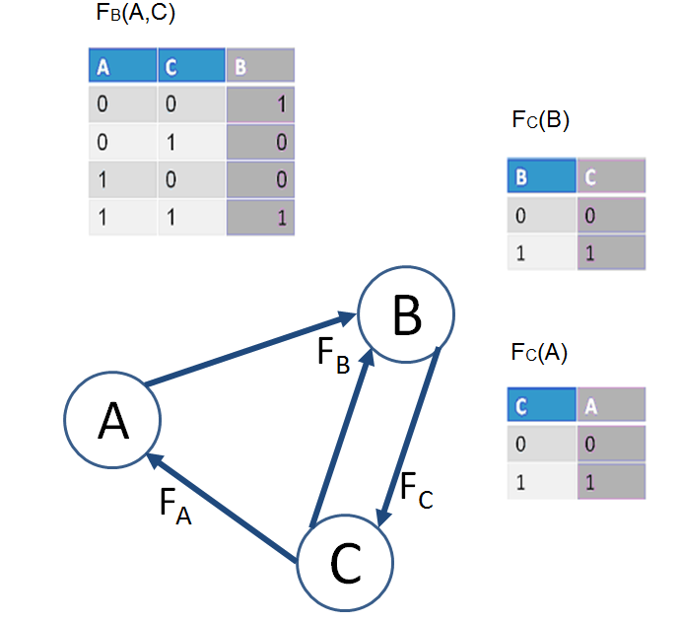
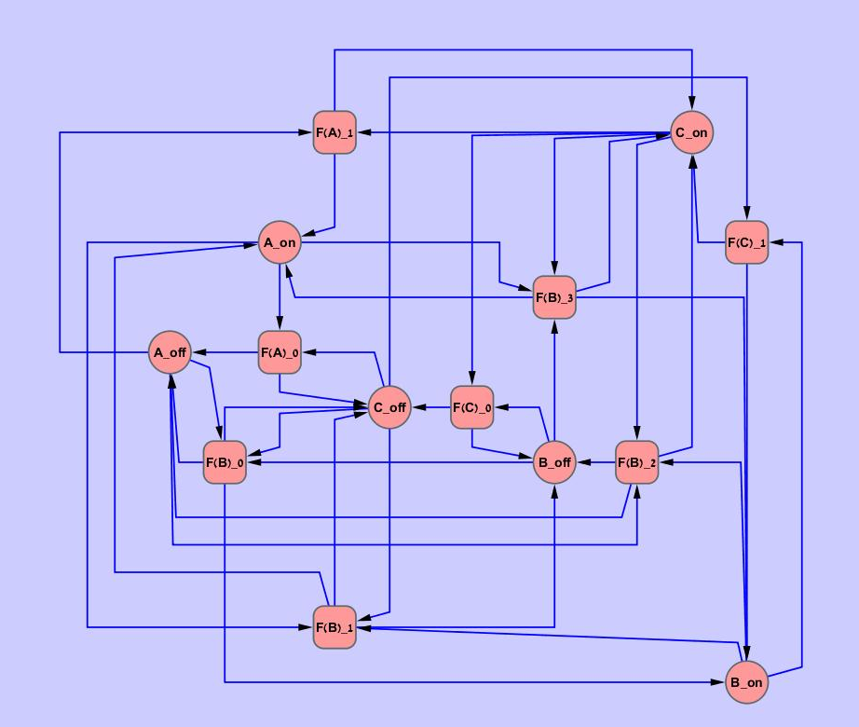
Boolean Network Encoding

Slide 9
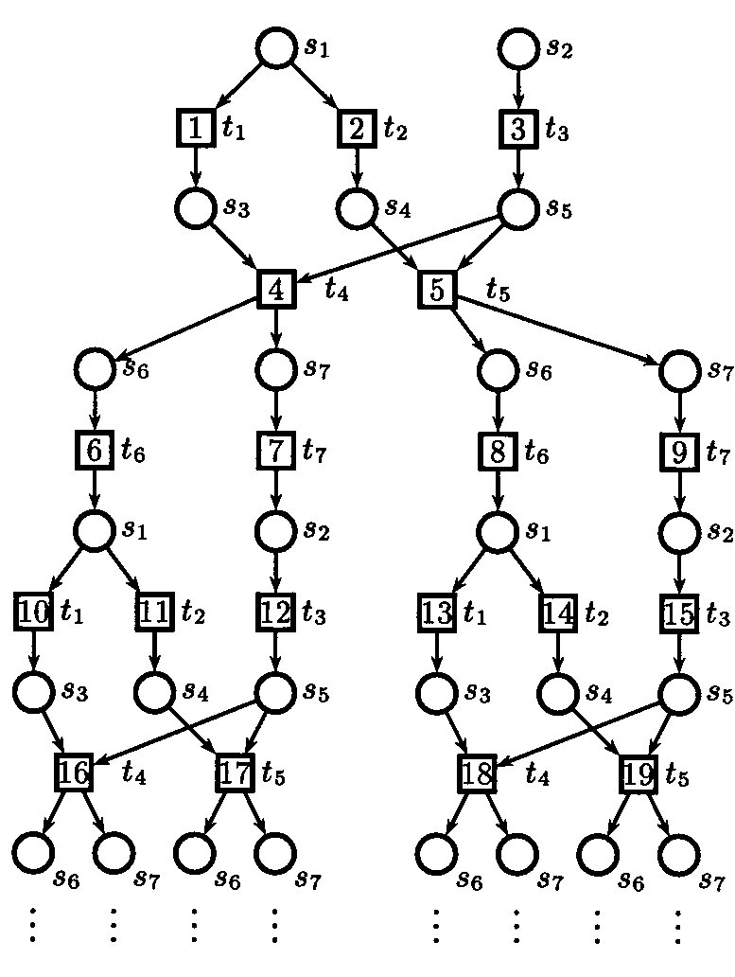
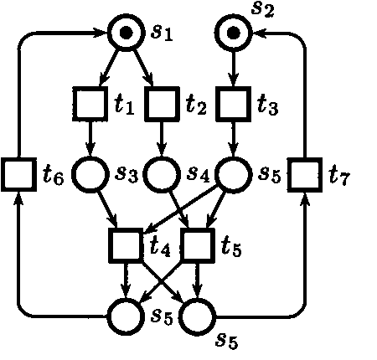
Unfolding of a Network
configuration
local configuration ([t₈])

Slide 10
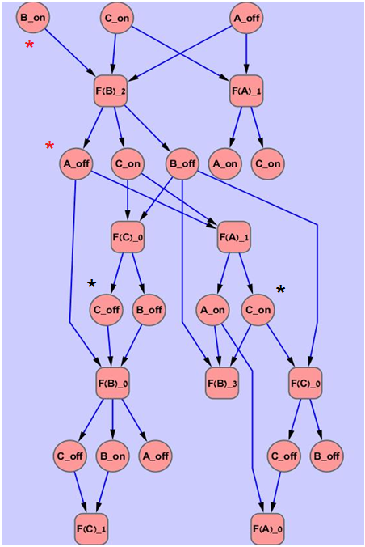
Causal, Conflict
initial state: (OFF,ON,ON)
black stars: conflict relationship
red stars: causal relationship

Slide 11
Finite Unfolding
McMillan introduced cutoff points, which produce a finite unfolding that represents every reachable state
A transition t is a cutoff point if:
The token marking represented by its local configuration is already represented by another transition t’, or by the initial marking
The size of the local configuration of t’ is smaller than that of t

Slide 12
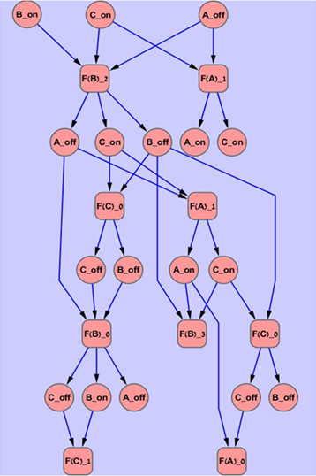
Cutoff Points
cutoff point

Slide 13
Sketch of the Proof
The infinite unfolding represents every reachable marking by its definition
Let C be a configuration that represents some reachable marking in the infinite unfolding
If C contains a cutoff point t in the finite unfolding, we can add to [t] all the transitions in C\[t]
We get a configuration that represents the same marking but is smaller
There’s no analysis that states when the algorithm works – it is based on intuition and practical experience (goes for model checking…)

Slide 14
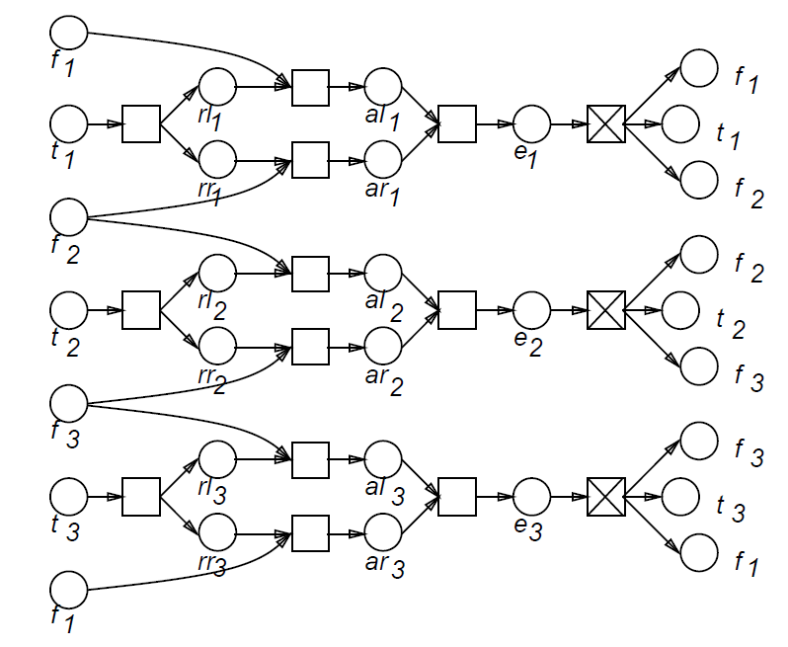
Unfolding Dining Philosophers

Slide 15
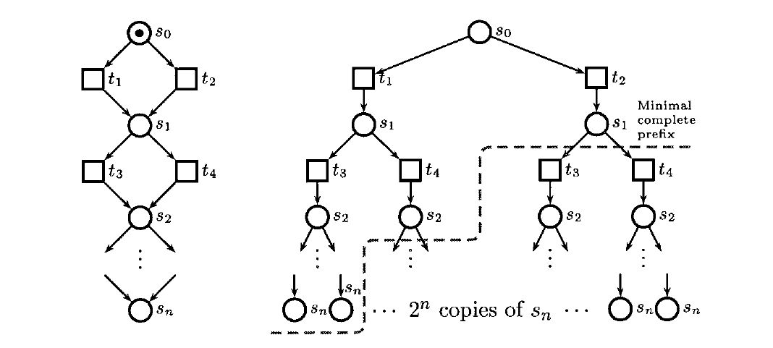
McMillan’s Criterion is Not Strict Enough

Slide 16
Improved Cutoff Criterion – Esparza Et Al.
Esparza et al. improved the cutoff criterion so that if the finite unfolding is only a constant times larger than the state space
Mark every local configuration with a string t_{i1} t_{i1} t_{i1} t_{i2} t_{i2} …t_{ij}t_{ij} where every t_{ik} repeats the number of times it appears in the local configuration
A transition t is a cutoff point if:
The token marking represented by its local configuration is already represented by another transition t’, or by the initial marking
The size of the local configuration of t’ is smaller than that of t, or its string is alphabetically smaller

Slide 17
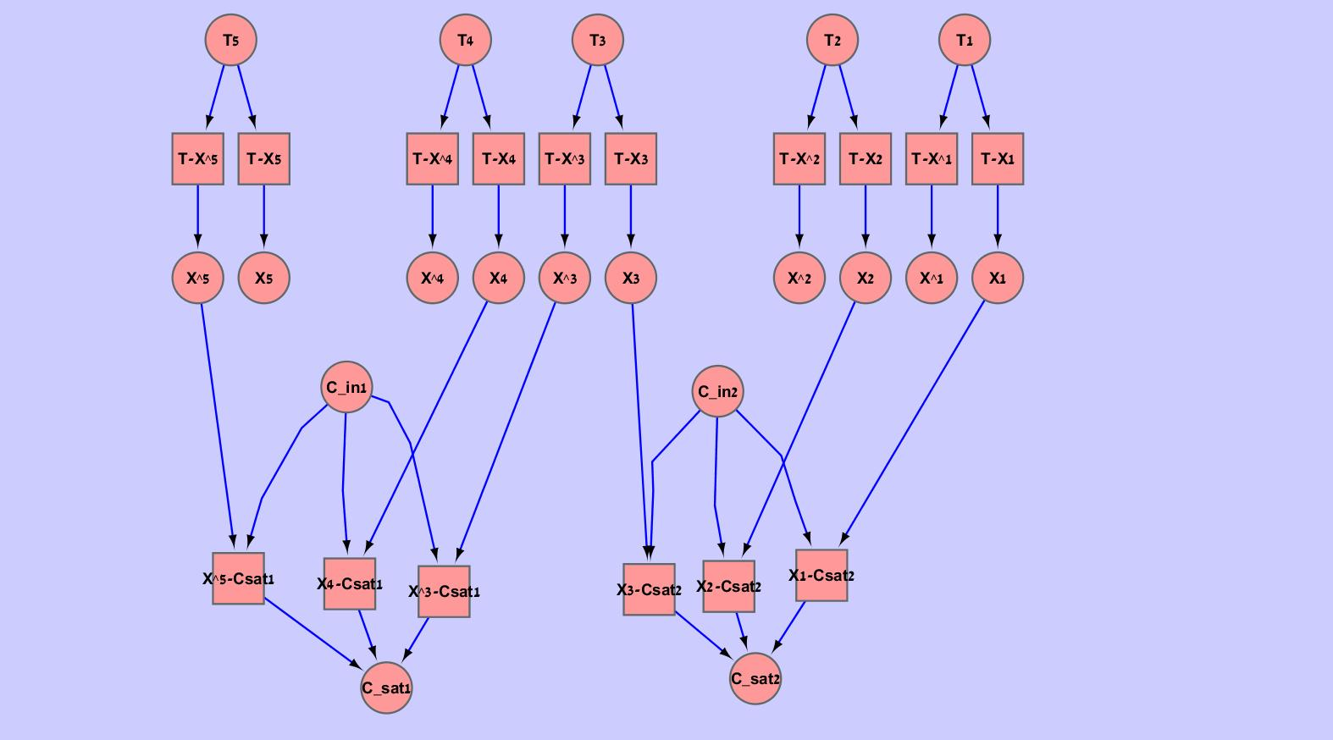
Selecting Concurrent Places is NP-Complete

Slide 18
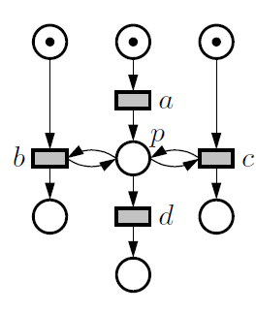
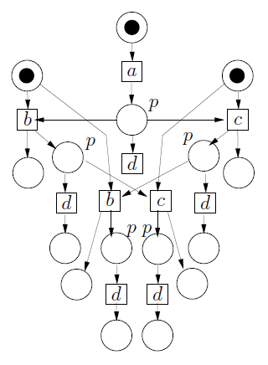
The Effect of Read Arcs
Let’s call b and c “readers” and d “consumer”
If we replace b and c by N transitions that read from p we will have O(N!) readers and consumers in the unfolding

Slide 19
An Improved Method For The Reachability Problem
Build a random subgraph of the finite unfolding
Since it is smaller, speed will increase because there will be less places to consider
In order to handle the probability for error that this introduces, do this many times
How exactly should a random subgraph be constructed?

Slide 20
Randomized Cutoff Criterion
Let N-1 be the maximal configuration size
Let 0<ϕ<1
t is some transition with local configuration [t]
Randomly choose a number 0<r<1
Cutoff if

Slide 21
Analysis Of Random Criterion
Set ϕ=0.5, and M is some marking that we want to find
Repeat the cutoff proof of Esparza, and assume that at every backwards step we encounter a cutoff point of maximal size
We get the sum
In the latter proof we assumed very strict assumptions:
We encounter a cutoff point at every step and its size is maximal
There is only one path that leads to the marking M

Slide 22
Smaller Slices Of The Unfolding
If we loosen the strict assumptions, we can slice off larger pieces off the unfolding, and thus handle larger networks
In particular we saw that read arcs can create many different paths to a marking (which is in fact a main source of the problem)
If there are K paths we get
For example, if K=3 and ϕ=0.99 the bound is ~0.526

Slide 23
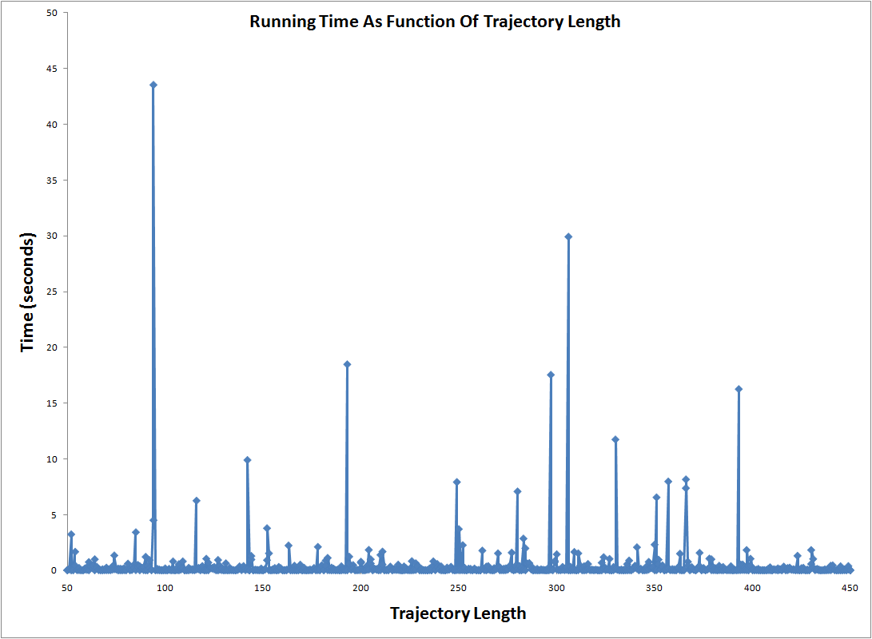
Size 50 Boolean networks – state space of size 2⁵⁰

Slide 24
Algorithm Parameters For Different Network Sizes
Size | φ | ρ (repetitions)
10 | 0.5 | 1
20 | 0.99 | 7
30 | 0.99 | 7
40 | 0.997 | 5
50 | 0.997 | 5
60 | 0.997 | 5
70 | 0.9995 | 5
80 | 0.9997 | 7
90 | 0.9997 | 7
100 | 0.9997 | 7

Slide 25
Asynchronous Cellular Automaton

